Slide 1

Algorithms
2. Computational Thinking

Slide 2
What is an algorithm?
An algorithm is a set of precisely defined instructions to solve a problem.
An algorithm is a finite step-by-step procedure to achieve a required result.
A computer program may contain thousands of algorithms, each one devoted to a single task.

Slide 3

Problem solving
with algorithms
INPUT
OUTPUT
PROCESS

Slide 4
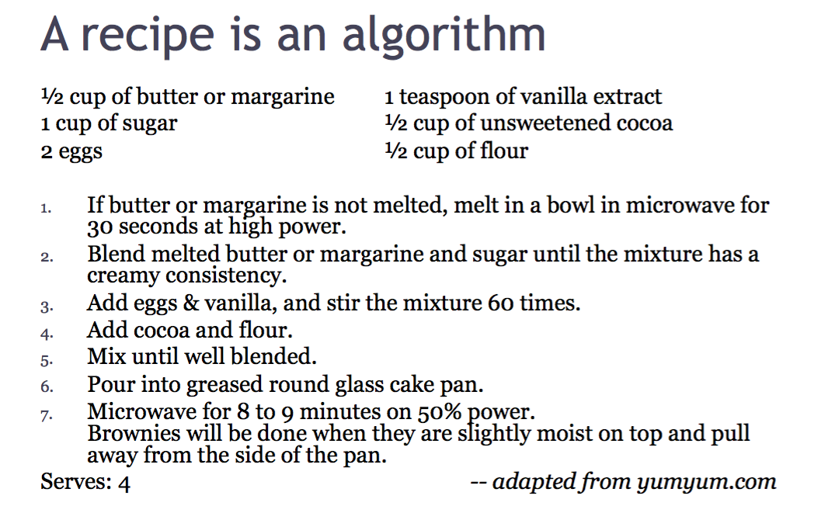

Slide 5
Problem solving
with algorithms
INPUT
OUTPUT
PROCESS

Slide 6
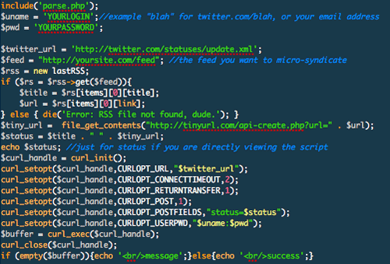
INPUT
OUTPUT
PROCESS

Slide 7
INPUT
Algorithms
OUTPUT
PROCESS

Slide 8
What does an algorithm needs? - Input
INPUT Specification:
INPUT Specification (for computational algorithms):

Slide 9
What does an algorithm needs? - Process
An algorithm requires clear and precisely stated steps that express how to perform the operations.
Algorithms assumes that basic set of primitive operations are understood by the executor of the algorithm.
Recipes: beat, stir, blend, bake, etc.
Computational: add, set, mod, etc.

Slide 10
What does an algorithm needs? - Output
Output specification
Recipes: number of servings, how to serve
Output specification for computational algorithms:
What results are required?
How should these results be reported?
What happens if no results can be computed due to an error in the input?

Slide 11
Optimization
What makes a good algorithm?

Slide 12


Slide 13
What makes a good algorithm?
A good algorithm should produce the correct outputs for any set of legal inputs.
A good algorithm should execute efficiently with the fewest number of steps as possible.
A good algorithm should be designed in such a way that others will be able to understand it and modify it to specify solutions to additional problems.

Slide 14
“Everything should be as simple as possible, but no simpler.”
Albert Einstein

Slide 15
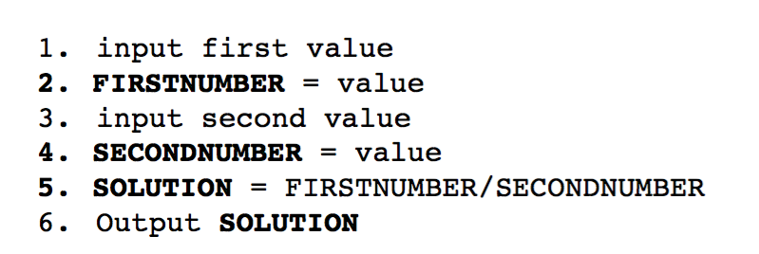
Quotient of 2 numbers

Slide 16
Quotient of 2 numbers

Slide 17
Quotient of 2 numbers

Slide 18
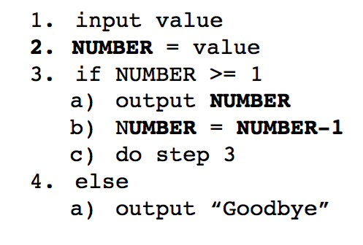
Display the number series from N to 1

Slide 19
Display the number series from N to 1

Slide 20
Display the number series from N to 1

Slide 21
Display the number series from N to 1
GOTO

Slide 22
Display the number series from N to 1
GOTO
“Prueba de escritorio”

Slide 23
Gracias.
@edolopez - edolopez@hackerschool.mx

